Slide 1
American Isolationism before WW1
Unit 2A Societies & Change

Slide 2
Key Terms
Isolationism - a policy of remaining apart from the affairs or interests of other groups, especially the political affairs of other countries.
Imperialism - The policy of extending a nation's authority by territorial acquisition or by the establishment of economic and political hegemony over other nations.
Hegemony -Leadership or dominance, especially by one state or social group over others.
Sphere of influence - A country or area in which another country has power to affect developments though it has no formal authority.
Foreign Policy – The making of deliberate choices to protect a nation’s world power and protect its self interest.

Slide 3
Introduction
‘The big fate Republic that is afraid of nothing because nothing up to the present day has ever happened to make her afraid, is as unprotected as a jellyfish.’
Rudyard Kipling speaking in 1891 about the USA
FOCUS QUESTION: How did the USA go from a policy of isolationism to become the strongest military power in the world?

Slide 4
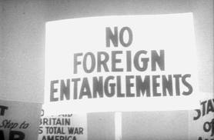
Non Intervention
“Our business with them, and theirs with us, is commerce, not politics, much less war”. – John Adams 1780 Foreign Envoy to Europe.
Non involvement was America’s policy pre-WW1.
The Pacific and Atlantic Oceans were also immense natural barriers hence no need to create a strong US navy.
There was no need for a strong army as no state on America’s was a major threat.

Slide 5
The Monroe Doctrine
1823 the Monroe Doctrine established the scope of American interests in early 19th century. The doctrine stated that:
US policy was to avoid becoming involved in European wars unless American interests were involved
The ‘American continents’ were not to be colonised by any European powers
Any such attempts at colonisation would be regarded as ‘unfriendly’ acts.

Slide 6
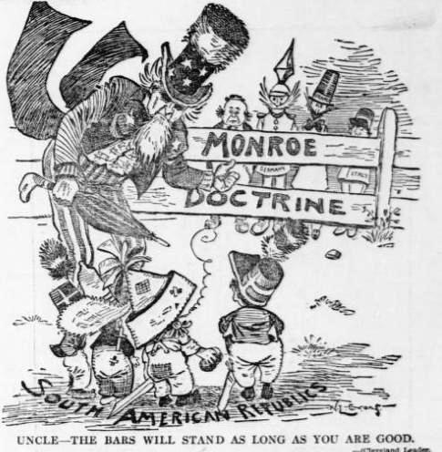

Slide 7
The Spanish-American War of 1898
Cuba was according to the Monroe Doctrine in USA’s sphere on influence.
Cuban revolutionaries demanded independence from Spain
INCIDENT 1
The Spanish ambassador criticised the President in a private letter.
Incident 2
February of 1898 the Maine exploded in Havana Harbour.
Perception that Spain in Cuba posed a military and economic threat.
WAR
In April 1898 the US launched a double attack on Spanish territories in the Philippines and in Cuba and defeated the Spanish troops after 17 days.

Slide 8
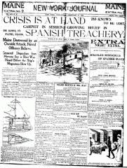
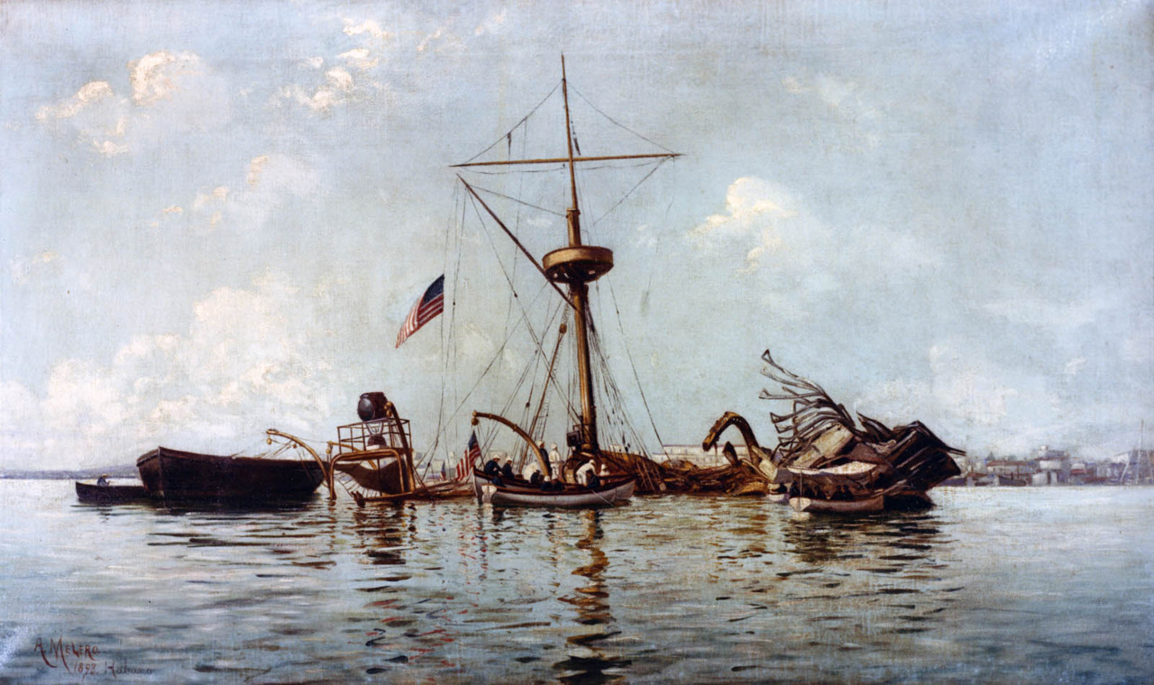

Slide 9
Spoils of War
Treaty of Paris of 1898 showed the USA as victors. It stated that:
Cuban independence was recognised but US influenced its constitution and took possession of Guantanamo Bay.
Spain lost Puerto Rico and Guam.
The US was able to purchase the Philippine Islands for $20 million.
The USA had demonstrated that it was willing to go to war to defend its spheres of influence and now also had Pacific bases.
Treatment of Filipinos by American soldiers led to a reaction against imperialism within the US

Slide 10
US Foreign Policy
Presidents became the major directors of foreign policy.
Theodore Roosevelt relished the control of foreign policy.
“The biggest matters, such as the Portsmouth Peace, the acquisition of Panama, and sending the fleet around the world I managed without consultations with anyone; for when a matter is of capital importance, it is well to be handled by one man only”. Roosevelt

Slide 11
Roosevelt’s annual message to Congress, 1904
..it is not true that the US feels any land hunger or entertains any project as regards the other nations of the Western Hemisphere save as for their welfare….but the adherence of the US to the Monroe Doctrine may force the United States, however reluctantly, in flagrant cases of such wrongdoing or impotence, to exercise as an international police power…We would interfere with them only in the last resort and then only if it became evident that their inability or unwillingness to do justice at home and abroad had violated the rights of the US or had invited foreign aggressions to the detriment of the entire body of American nations.

Slide 12
WW1
The US believed that the war that broke out in 1914 was a European dispute. The US claimed neutrality, however neutrality was impossible with America trading with Britain and France
There was an increase in peace movements within the US that argued against the corruption of war, the loss of young lives and the inadequacy of war as a solution.

Slide 13
Steps towards war
Lusitania, a passenger ship, was sunk by German submarines in 1915. 1200 people died and America was shocked that civilians were now enemy targets.
Germany resumed unrestricted submarine warfare against all shipping around Britain and France in 1917.
The Zimmerman Telegraph, 1917. Invitation from Germany to Mexico to enter WW1 on the side of the Alliance Powers. They would be given Texas, New Mexico and Arizona. Outraged public opinion and generated support for the US entering the war.

Slide 14
Declaration of war
March 1917 ordered all merchant ships to be armed and that the navy should fire on U-boats.
Germany responded by sinking 5 American ships in one week.
The President asked congress for a declaration of war on Germany.
….I advise that congress declare the recent course of the Imperial Government to be in fact nothing less than war against the government and people of the United States…to take immediate steps not only to put the country in a more thorough state of defence but also to exert all its power and employ all its resources to bring the Government of the German Empire to terms….. (President Wilson, Address to Congress, 1917

